Slide 1
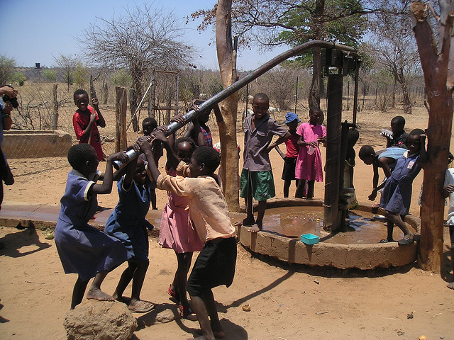

Data mining the water table
Statistical foundations of machine learning
Robin De Haes Dieter Vandesande Seppe Renty

Slide 2
Data exploration

Slide 3
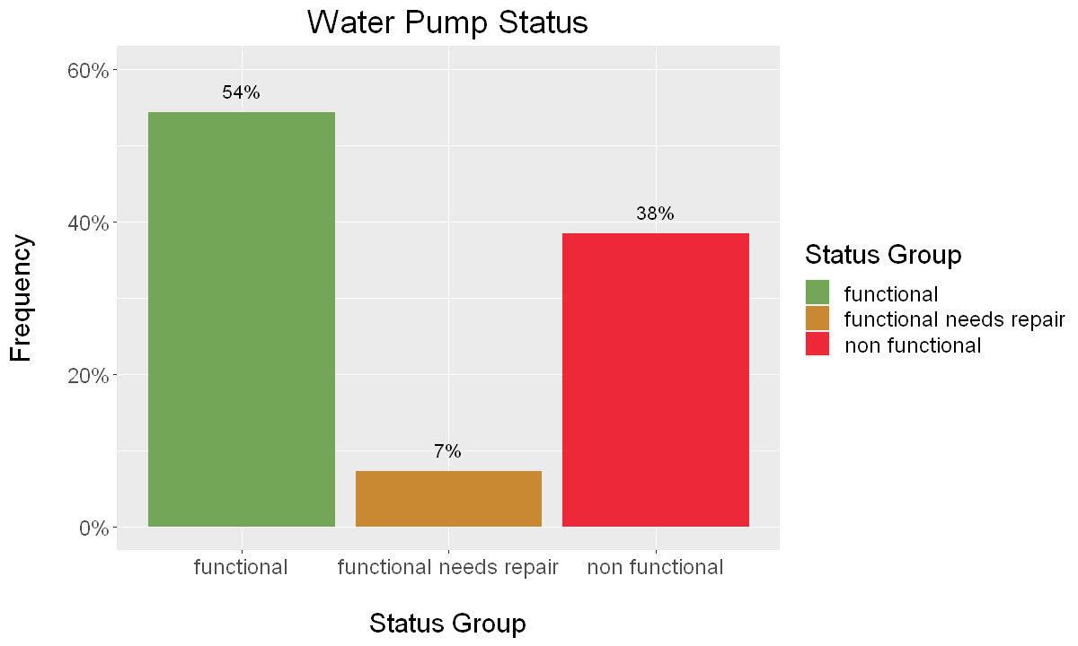
Status group
Target labels

Slide 4
features
amount_tsh | gps_height | latitude | basin | region_code
date_recorded | waterpoint_type_group | wpt_name | subvillage | district_code
funder | management_group | num_private | region | lga
longitude | extraction_type_group | id | management | installer
quantity | extraction_type_class | source | source_type | source_class
permit | extraction_type | water_quality | quality_group | recorded_by
construction_year | scheme_management | payment_type | quantity_group | scheme_name
ward | population | public_meeting | payment | waterpoint_type

Slide 5
features
amount_tsh | gps_height | latitude | basin | region_code
date_recorded | waterpoint_type_group | wpt_name | subvillage | district_code
funder | management_group | num_private | region | lga
longitude | extraction_type_group | id | management | installer
quantity | extraction_type_class | source | source_type | source_class
permit | extraction_type | water_quality | quality_group | recorded_by
construction_year | scheme_management | payment_type | quantity_group | scheme_name
ward | population | public_meeting | payment | waterpoint_type
Numerical

Slide 6
features
amount_tsh | gps_height | latitude | basin | region_code
date_recorded | waterpoint_type_group | wpt_name | subvillage | district_code
funder | management_group | num_private | region | lga
longitude | extraction_type_group | id | management | installer
quantity | extraction_type_class | source | source_type | source_class
permit | extraction_type | water_quality | quality_group | recorded_by
construction_year | scheme_management | payment_type | quantity_group | scheme_name
ward | population | public_meeting | payment | waterpoint_type
categorical

Slide 7
features
amount_tsh | gps_height | latitude | basin | region_code
date_recorded | waterpoint_type_group | wpt_name | subvillage | district_code
funder | management_group | num_private | region | lga
longitude | extraction_type_group | id | management | installer
quantity | extraction_type_class | source | source_type | source_class
permit | extraction_type | water_quality | quality_group | recorded_by
construction_year | scheme_management | payment_type | quantity_group | scheme_name
ward | population | public_meeting | payment | waterpoint_type
redundancy

Slide 8
features
amount_tsh | gps_height | latitude | basin | region_code
date_recorded | waterpoint_type_group | wpt_name | subvillage | district_code
funder | management_group | num_private | region | lga
longitude | extraction_type_group | id | management | installer
quantity | extraction_type_class | source | source_type | source_class
permit | extraction_type | water_quality | quality_group | recorded_by
construction_year | scheme_management | payment_type | quantity_group | scheme_name
ward | population | public_meeting | payment | waterpoint_type
redundancy

Slide 9
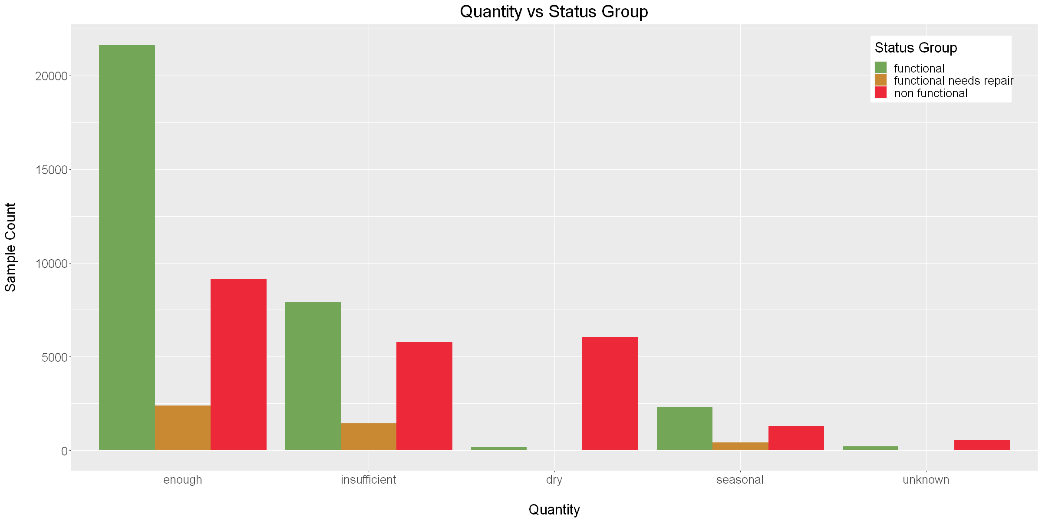
informative
quantity

Slide 10
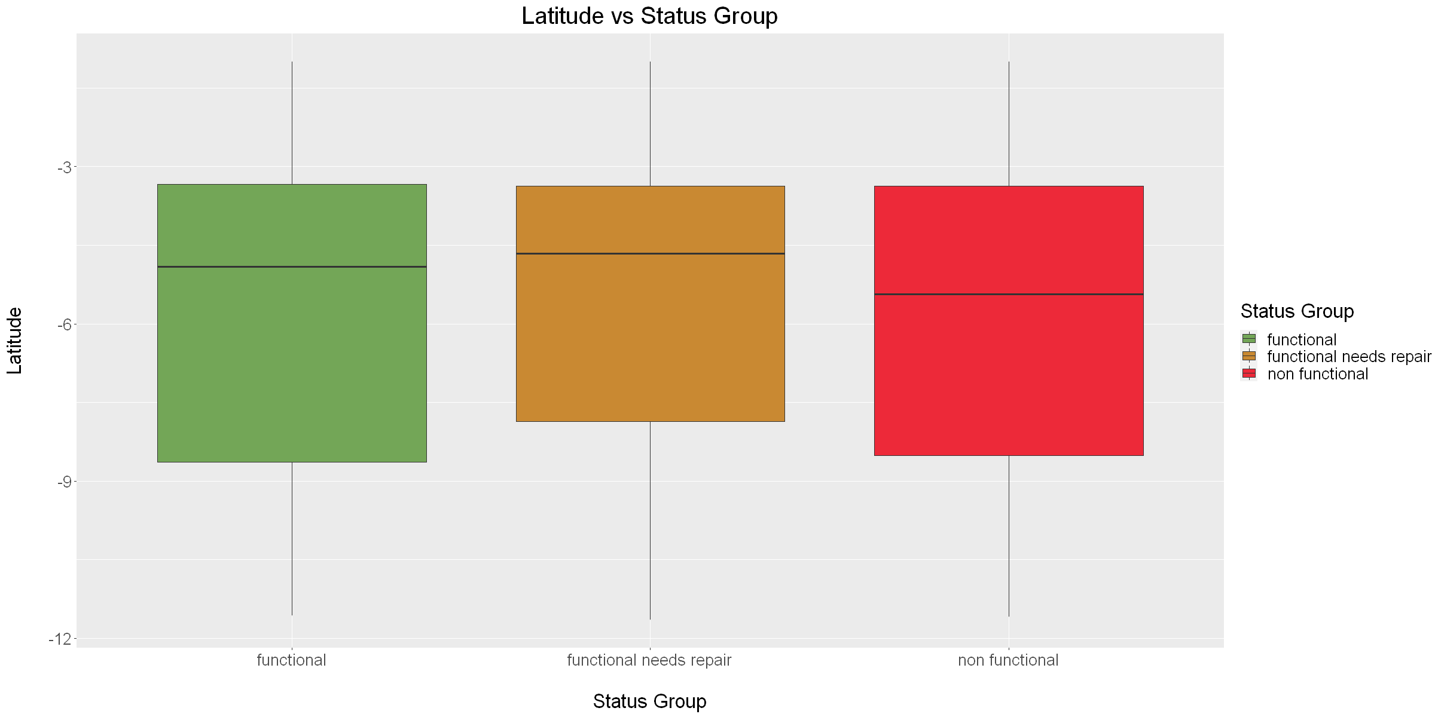
(un)Informative?
latitude

Slide 11
Data preprocessing

Slide 12
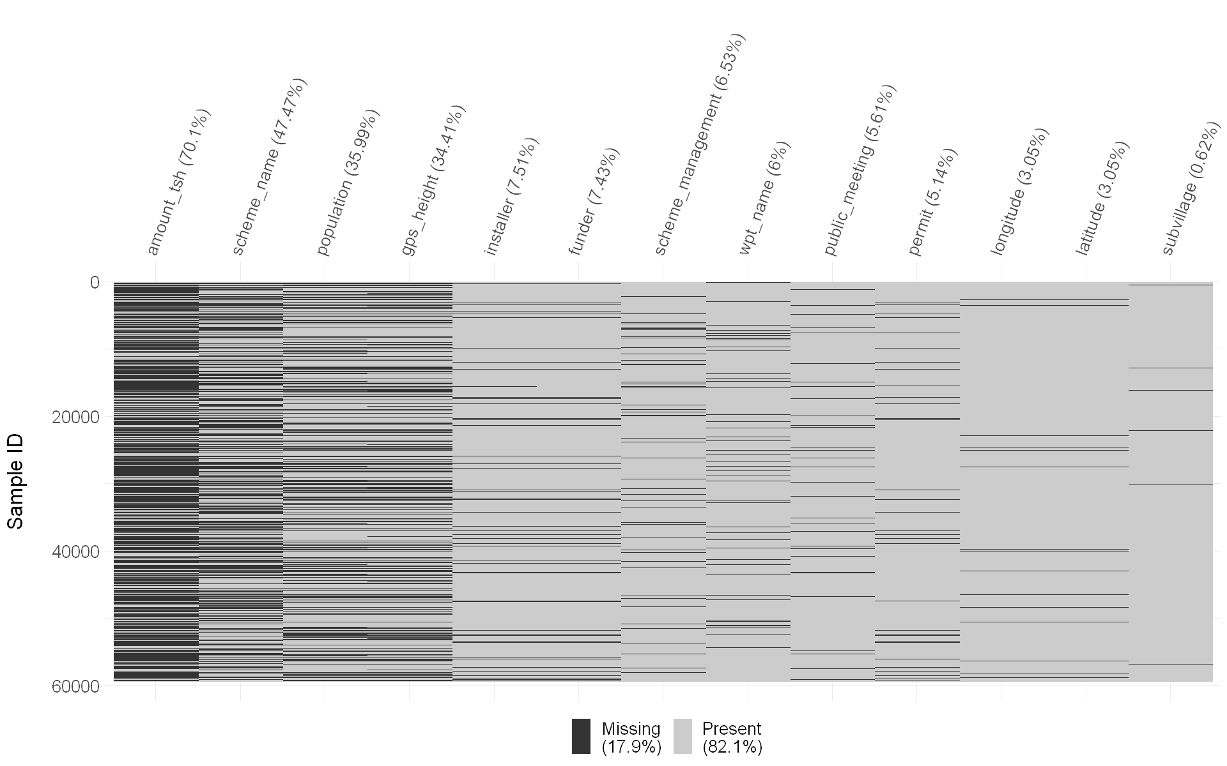
Missing values
prevalence

Slide 13
Missing value imputation
categorical
empty string (‘’)
-
0
not known
unknown
none
no
unknown

Slide 14
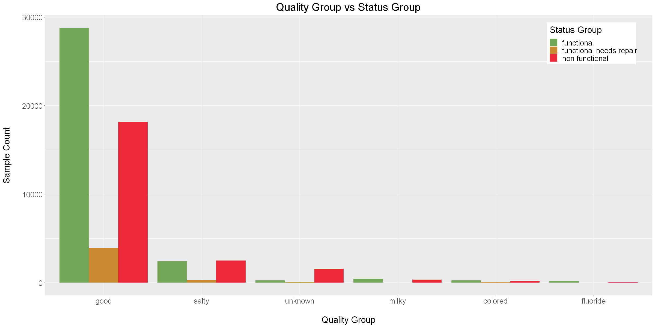
Missing value imputation
categorical

Slide 15
Missing value imputation
numerical
0 Invalid?
Median
Geographic mean

Slide 16
Missing value imputation
numerical
SAMPLES
0 Invalid?
Median
Geographic mean
REGION
WARD

Slide 17
Missing value imputation
numerical
SAMPLES
0 Invalid?
Median
Geographic mean
REGION
WARD

Slide 18
Missing value imputation
numerical
SAMPLES
0 Invalid?
Median
Geographic mean
REGION
WARD

Slide 19
Feature engineering
Creation & modification
SAMPLES
Creation
pump_age
= date_recorded[year] - construction_year
season
= seasonal binning of date_recorded[month]
Modification
Manual splits/merges
Low-frequency merging (< 1%)

Slide 20
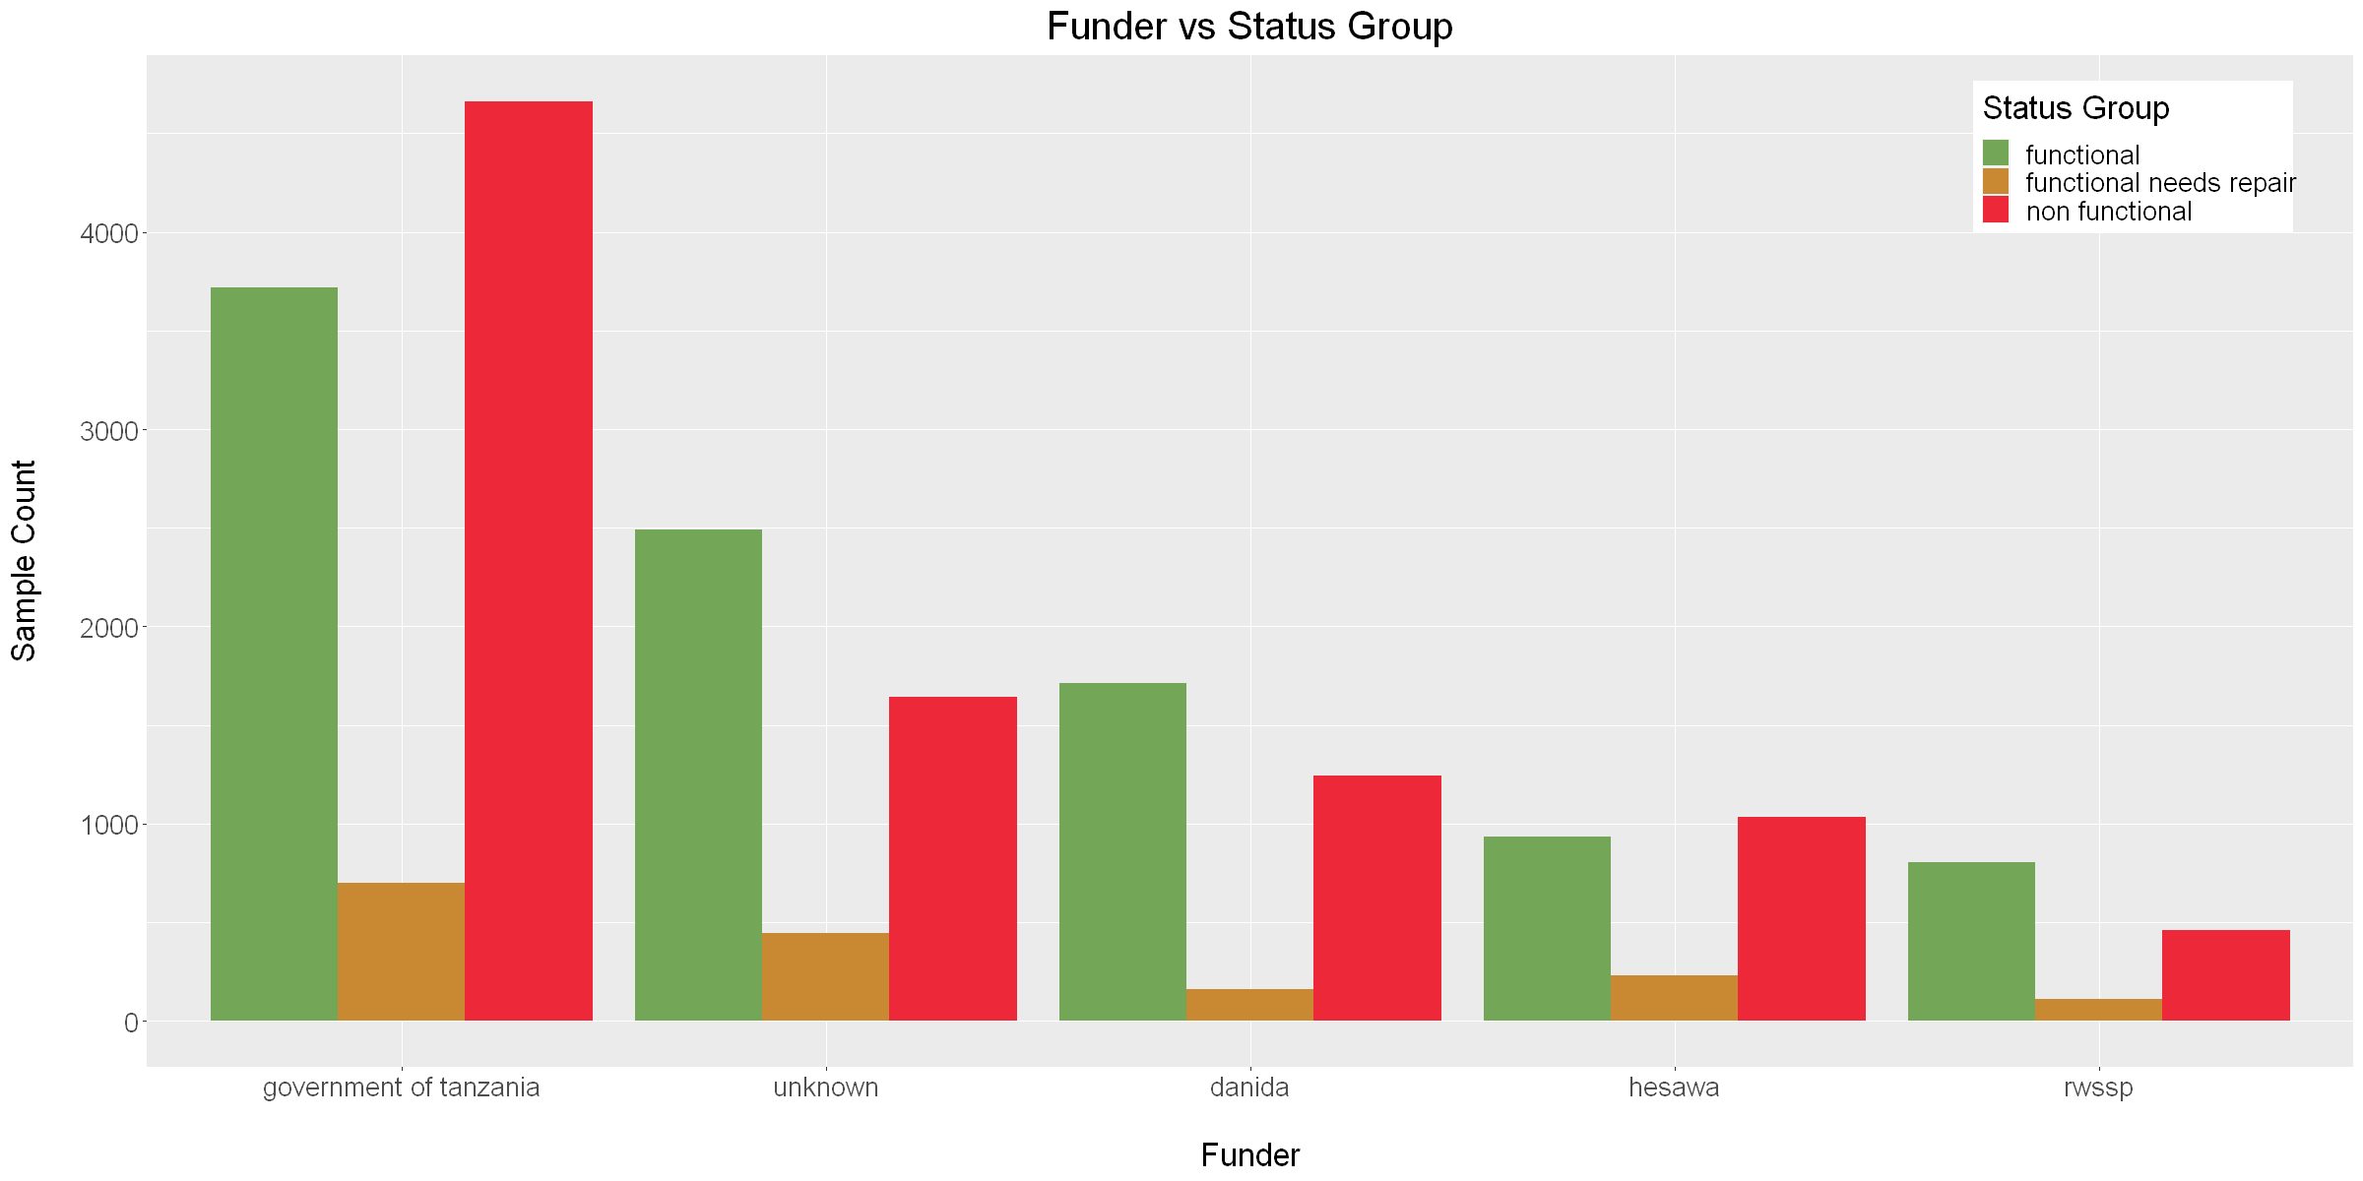
Feature engineering
Creation & modification
SAMPLES
Creation
pump_age
= date_recorded[year] - construction_year
season
= seasonal binning of date_recorded[month]
Modification
Manual splits/merges
Low-frequency merging (< 1%)

Slide 21
Feature selection
filter
SAMPLES
Manual selection
Dropping redundant features
Automatic selection
One-hot encoded features
Maximum Relevancy Minimum Redundancy (80 features)

Slide 22
Preprocessing pipeline
Training data
Numerical
Missing value imputation
Drop redundants
New Data
Data
Create new features
Geographic info
Info
for
Test
Drop redundants
Lowercase
Low-frequent merging
Encode
mRMR
Scale
Categorical

Slide 23
Preprocessing pipeline
Optional Settings
Numerical
Missing value imputation
Drop redundants
New Data
Data
Create new features
Geographic info
Info
for
Test
Drop redundants
Lowercase
Low-frequent merging
Encode
mRMR
Scale
Categorical

Slide 24
Tuning MODELS
Notes:
For this part of the project, we tested multiple models.

Slide 25
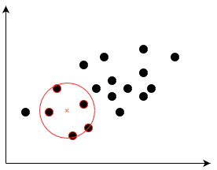
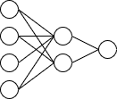
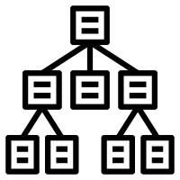
tuning MODELS
KNN
NNET
RANDOM FORESTS
Notes:
We will highlight the following models more in depth: kNN, Neural Networks and Random Forests.

Slide 26
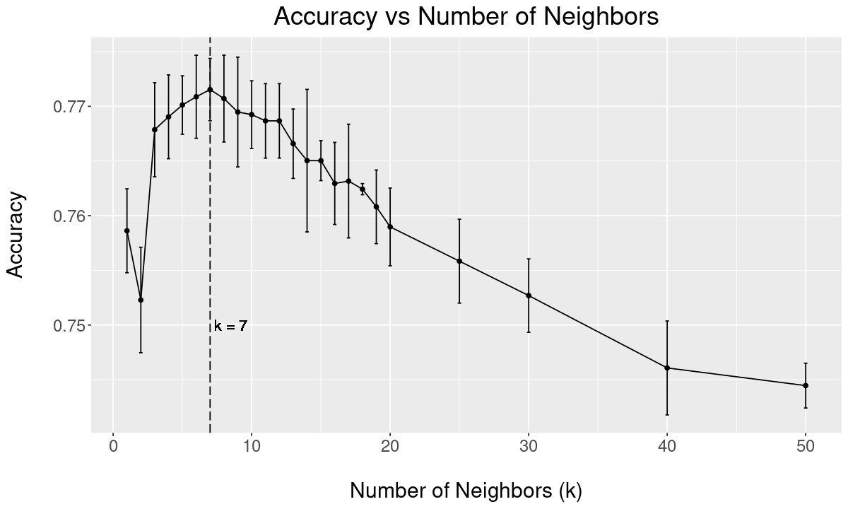
kNN
Hyperparameter tuning
Preprocessing used:
One Hot Encoding
Scaling
mRMR
K = number of neighbours
Distance = Euclidean
Notes:
We start by exploring the k-nearest neighbour model. To be able to calculate the Euclidean Distance, we need to use the one hot encoded version of the categorical variables. We will also need to have the data scaled and to mitigate the curse of high dimensionality, we filter the number of variables using mRMR. In the graph, we can see that for a small number of neighbours, we can add more neighbours to the model to have a better accuracy. When having too many neighbours, the variance of the predictions would be too high. This is a clear example of the Bias/Variance tradeof. We can see that the maximum accuracy is reached using 7 neighbours, which is way smaller than the default square root of the number of samples.

Slide 27
knn
Model analysis
Accuracy of 77.5 % +/- 0.2 %
Prediction -> | Functional | Functional Needs repair | Non Functional
Functional | 87.3% | 2.2% | 10.5%
Functional Needs repair | 53.7% | 28.8% | 17.2%
Non Functional | 26.2% | 1.9% | 71.9%
Notes:
The maximum accuracy reached using KNN was 77.5%. This is a good baseline, since KNN is quite fast and the accuracy is not that bad. Nevertheless, the classification rate of Functional Needs Repair is poor, mostly due to the inbalanced dataset.

Slide 28
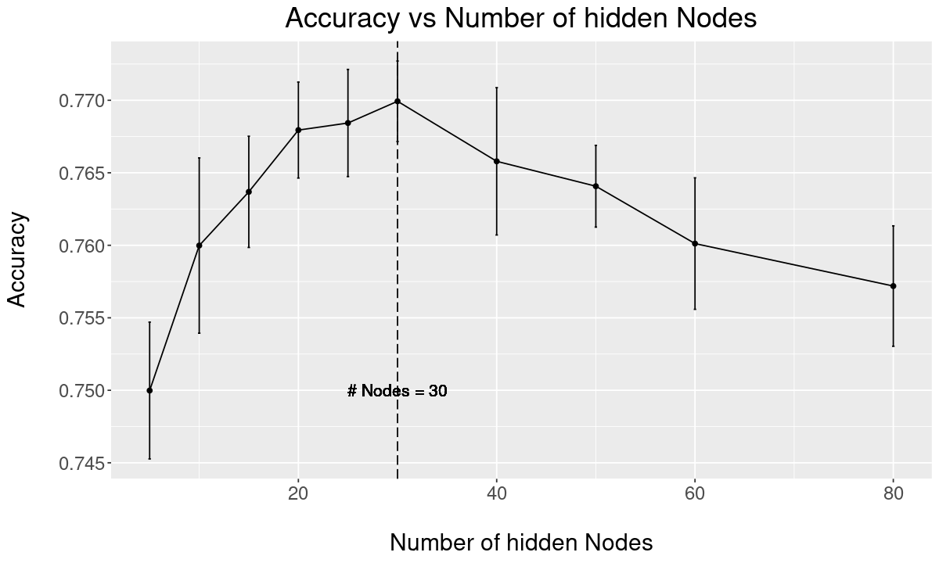
NNET
Hyperparameter tuning
Preprocessing used:
One Hot Encoding
Scaling
mRMR
Size of the hidden layer
Decay
Notes:
Now we will look a bit further into neural networks. The most important hyper parameters are the number of nodes in the hidden layer and the decay, which is a parameter that penalizes high value weights to avoid overfitting. We first tuned the number of hidden nodes. The best number of hidden nodes seem to be 30, so that we have enough complexity in the model but we do not overfit the model on the trainingdata.

Slide 29
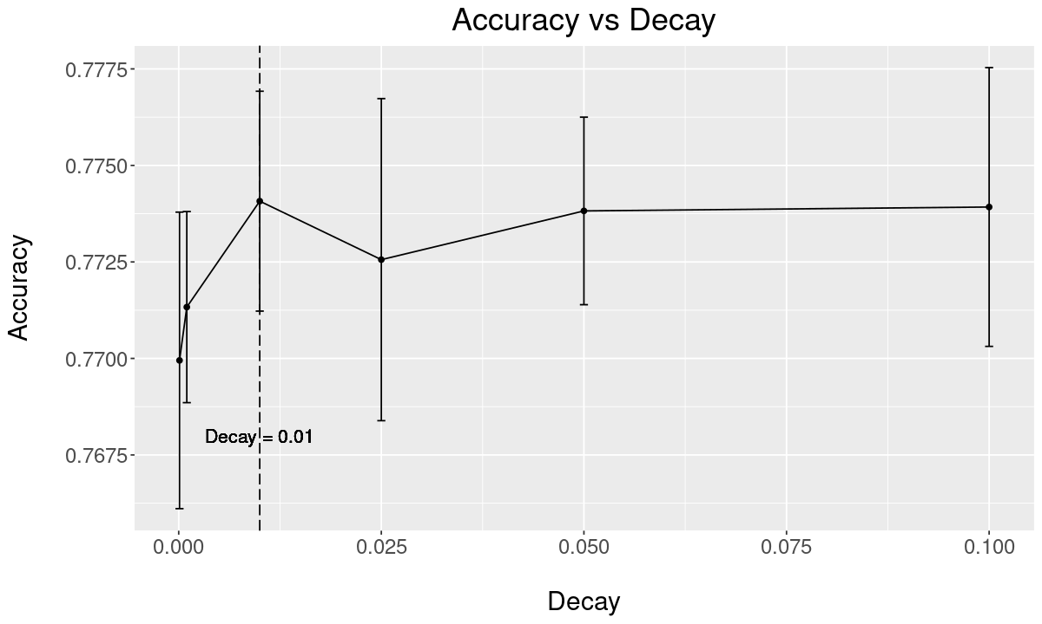
NNET
Hyperparameter tuning
Preprocessing used:
One Hot Encoding
Scaling
mRMR
Size of the hidden layer
Decay
Notes:
The decay is by default equal to zero. We see that when we increase the decay, the accuracy seems to increase slightly.

Slide 30
NNET
Model analysis
Accuracy of 77.4 % +/- 0.4 %
Prediction -> | Functional | Functional Needs repair | Non Functional
Functional | 86.8% | 2.2% | 11%
Functional Needs repair | 54.9% | 26.2% | 18.9%
Non Functional | 25.0% | 1.8% | 73.2%
Notes:
The accuracy and the confusion matrix is comparable to the one of k nearest neighbours. However, it should be noted that neural networks’ computational cost is a lot higher than kNN’s computational cost.

Slide 31
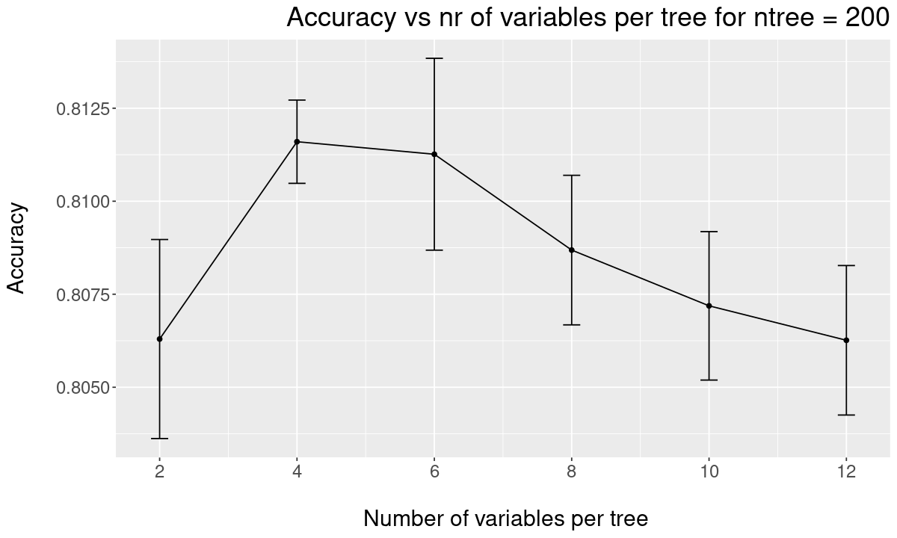
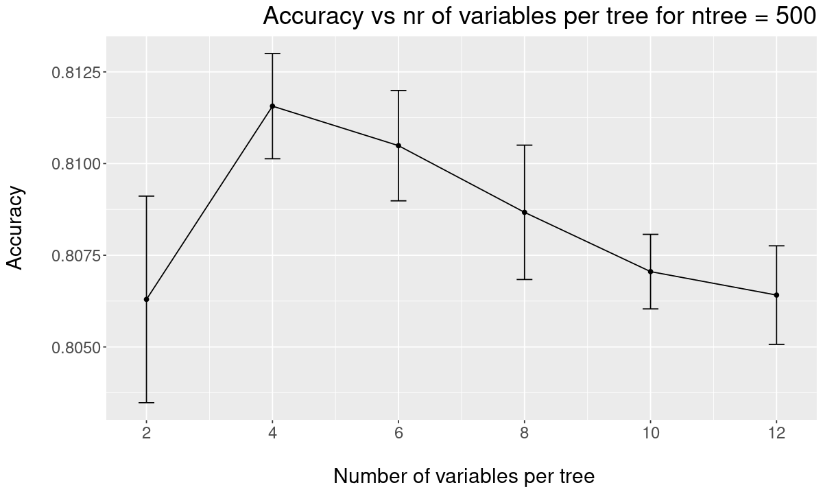
Random forest
Hyperparameter tuning
Preprocessing needed:
Categorical Data
Number of variables per tree
Number of trees per forest
Notes:
A random forest combines bagging and random feature selection to reduce the variance of multiple non-pruned decision trees. The two main hyperparameters we tuned are the number of variables per tree and the number of trees the forest consists of. On this slide, we show the influence of the number of variables per tree on the accuracy. When having less than 4 variables per tree, we have too little information per tree. Nevertheless, when we add too many variables to each tree, the trees are mutually correlated, which reduces the accuracy of the random forest.

Slide 32
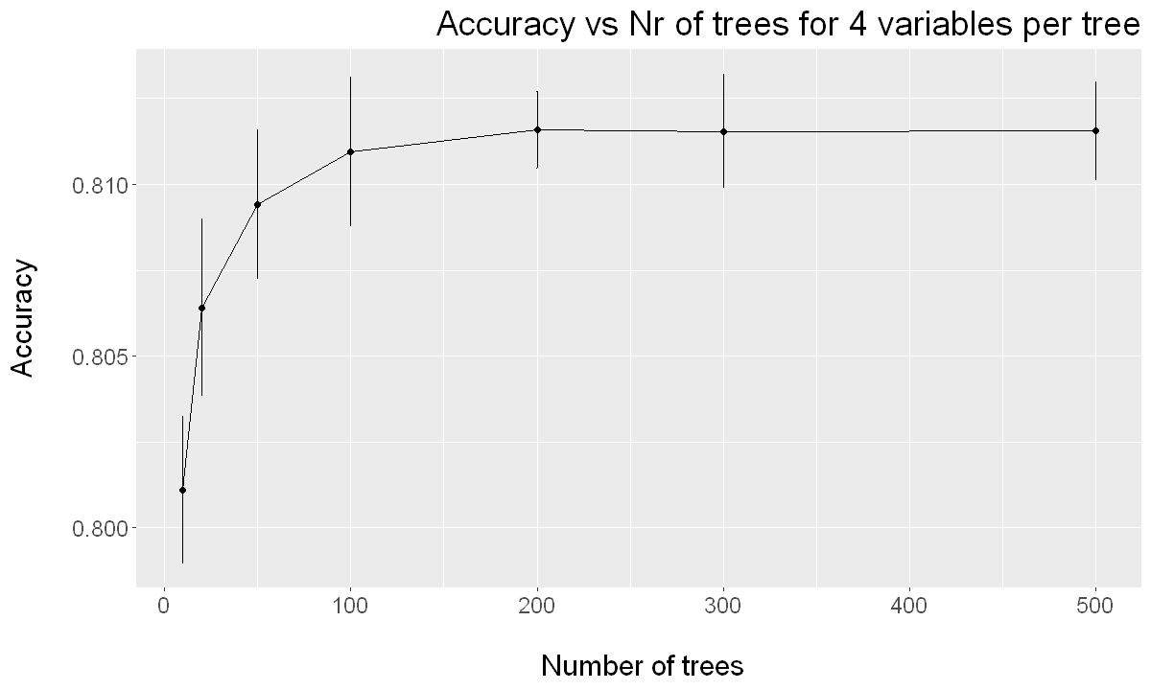
Random forest
Hyperparameter tuning
Preprocessing needed:
Categorical Data
Number of variables per tree
Number of trees per forest
Notes:
The graph on this slide shows that when the accuracy of a random forest has converged, adding more trees will neither increase, nor decrease the accuracy. Since it seems that the random forest has converged after 200 trees, we use 200 as the optimal value for the number of trees.

Slide 33
Random forest
Model analysis
Accuracy of 81.2 % +/- 0.1 %
Prediction -> | Functional | Functional Needs repair | Non Functional
Functional | 90.0% | 2.0% | 8.0%
Functional Needs repair | 53.4% | 32.4% | 14.2%
Non Functional | 21.0% | 1.3% | 77.6%
Notes:
Random forest had a high accuracy of 81.2% with a low standard deviation on the crossvalidated accuracy. However, random forests are still suffering from the inbalanced dataset.

Slide 34

Comparison of all the tuned models
Model | Accuracy +/- SD
ElasticNet | 73.8 +/- 0.6
Decision Tree | 78.7 +/- 0.4
Random Forest | 81.2 +/- 0.1
kNN | 77.5 +/- 0.3
SVM | 77.9 +/- 0.5
Neural Network | 77.4 +/- 0.4
Notes:
In this slide we compare the presented models to a few others we tested. We see that Random Forest is the best model among them. We created a submission to the DrivenData contest using a random forest trained on the whole dataset and received an accuracy of 81.72% on the test set.

Slide 35
ALTERNATIVE MODELS
Notes:
The last section of our report constists out of alternative models. Here we combined preprocessing and model selection to generate a learner with highest accuracy.

Slide 36
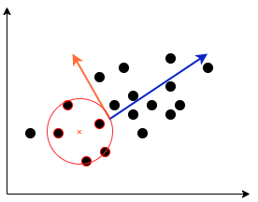
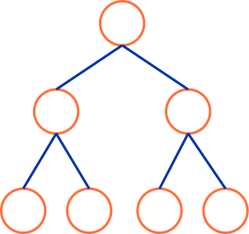
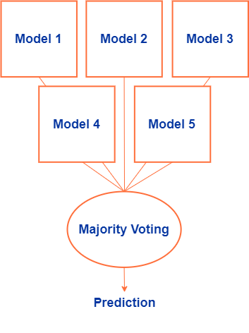
ALTERNATIVE MODELS
Gradient Boosting Trees
Ensemble of models
KNN with PCA
Notes:
There were 3 strategies tried in this last section.
- Gradient boosting trees with the library XGboost
- An ensemble of models in which we combine gradient boosting trees and random forrests
- An lastly we experimented with KNN using PCA.
I will quickly summarize these three approaches.

Slide 37
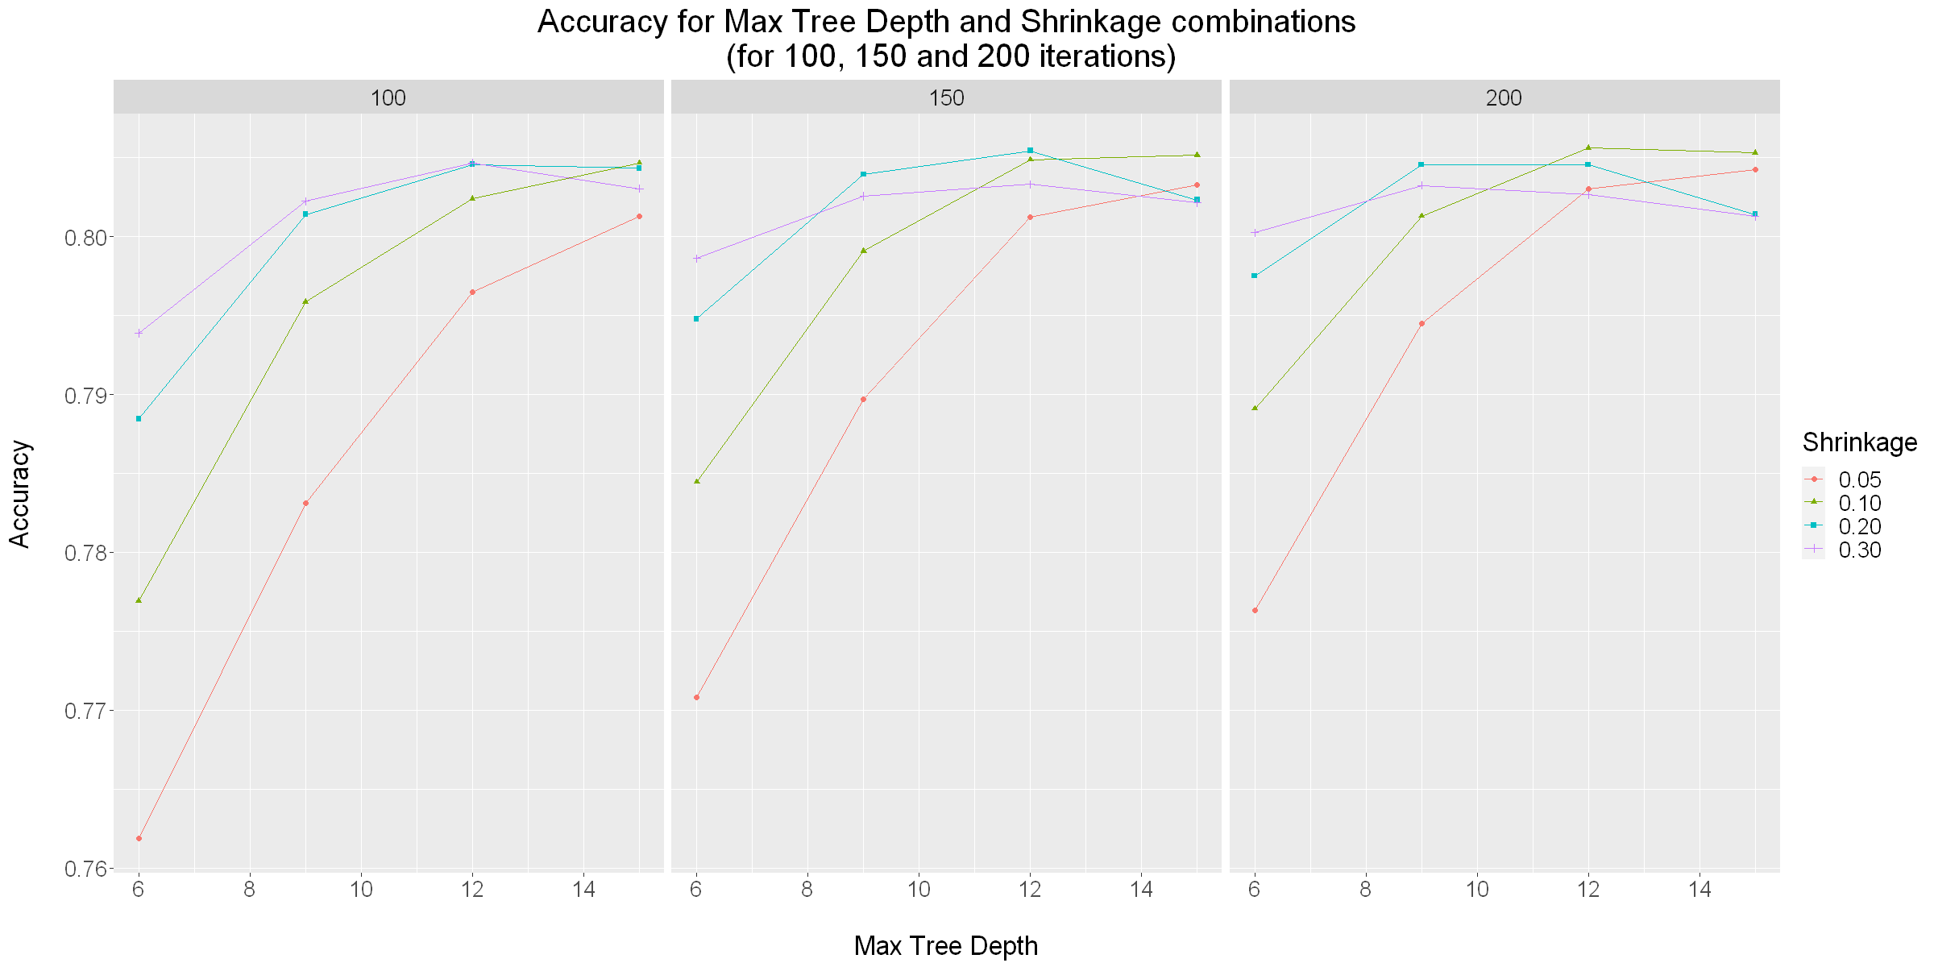
GRADIENT BOOSTING TREES
Hyperparameter tuning
Nrounds
Eta
Max depth
Min child weight
Colsample Bytree
Notes:
It made sense to use a gradient boosting tree model as we saw from the previous section that trees were the best performing models.
- The gradient boostin tree model is a model in which weak learners in the form of decision trees are trained iteratively in a number of rounds. Each tree tries to correct the errors made by the previous one. The combination of these weak learners form together a strong learner.
There are some hyperparameters to tune as listed on the slide on the left.
Al these parameters where gridsearched on the right we see one of the multple plots generated from these gridsearched. This shows the cooperation between three parameters shrinkage or learning rate. The max depth of the tree (one of the parameters which represents the complexity of a tree) and also the number of rounds. We see clearly that a low learning rate translates to slower convergence.

Slide 38
GRADIENT BOOSTING TREES
Model analysis
Accuracy of 81.4 % +/- 0.2 %
Prediction -> | Functional | Functional Needs repair | Non Functional
Functional | 91.4% | 1.6% | 7.1%
Functional Needs repair | 56.1% | 29.9% | 14.1%
Non Functional | 21.9% | 1% | 77.1%
Notes:
As a result we have the tuned parameters on the left. And achieved an accuracy of 81.4% which is quite good. In the confusion matrix we see that functional reaches high accuracy but this is at cost of te other classes. Functional needs repair still has the worst accuracy.

Slide 39
ENSEMBLE of models
Gradient Boosting Trees
Gradient Boosting / Random Forest
Gradient Boosting + Balancer
Notes:
The second strategy we tried were ensemble models. Our best performing models are complex models like gradient boosting trees and random forrests. We decided to try an ensemble which combines a couple of these models into one learner. Averaging a couple of complex models could have a beneficial effect.
- First we combined 5 gradient boosting trees each trained with another random seed.
- Next we tried 2 boosting trees and 2 random forrests. This combines more varyng models which could have a beneficial effect.
- And lastly we tried 5 gradient boosting trees in which one tree was trained on a weighted training set. As said before the trainins data is higly unbalanced, this was chalanced by adding higher weights to the low frequency classes and low weights to the high frequency classes. The rationale behind this is that this balanced learner could act as a tie breaker when the other learners don't agree.

Slide 40
ENSEMBLE of BOOSTING TREES
Gradient Boosting Trees
Gradient Boosting & Random Forest
Gradient Boosting +
Balanced Tree
Learner | Accuracy
XGBTree 1 | 81.34 +/- 0.40 %
XGBTree 2 | 81.29 +/- 0.38 %
XGBTree 3 | 81.34 +/- 0.44 %
XGBTree 4 | 81.30 +/- 0.42 %
XGBTree 5 | 81.36 +/- 0.40 %
Ensemble | 81.35 +/- 0.38 %
Learner | Accuracy
XGBTree 1 | 81.34 +/- 0.40 %
XGBTree 2 | 81.29 +/- 0.38 %
RF 1 | 81.13 +/- 0.33 %
RF 2 | 81.15 +/- 0.37 %
Ensemble | 81.37 +/- 0.36 %
Learner | Accuracy
XGBTree 1 | 81.32 +/- 0.34 %
XGBTree 2 | 81.38 +/- 0.46 %
XGBTree 3 | 81.27 +/- 0.46 %
XGBTree 4 | 81.31 +/- 0.40 %
XGBTree (Bal.) | 74.73 +/- 1.04 %
Ensemble | 81.37 +/- 0.43 %
Notes:
Looking at the results we see for each ensemble and for each separate learner the accuracy. In general the ensemble accuracy is not significantly higher than the individual learner. We do see some increase in the combination of gradient boosting trees and random forrests in the middle. Tis could be because the two models have different strengths, and combining these is beneficial. It would be interesting to increase the amount of models which could increase the accuracy even more. However This would be computationally to expense for use to include in this project.

Slide 41
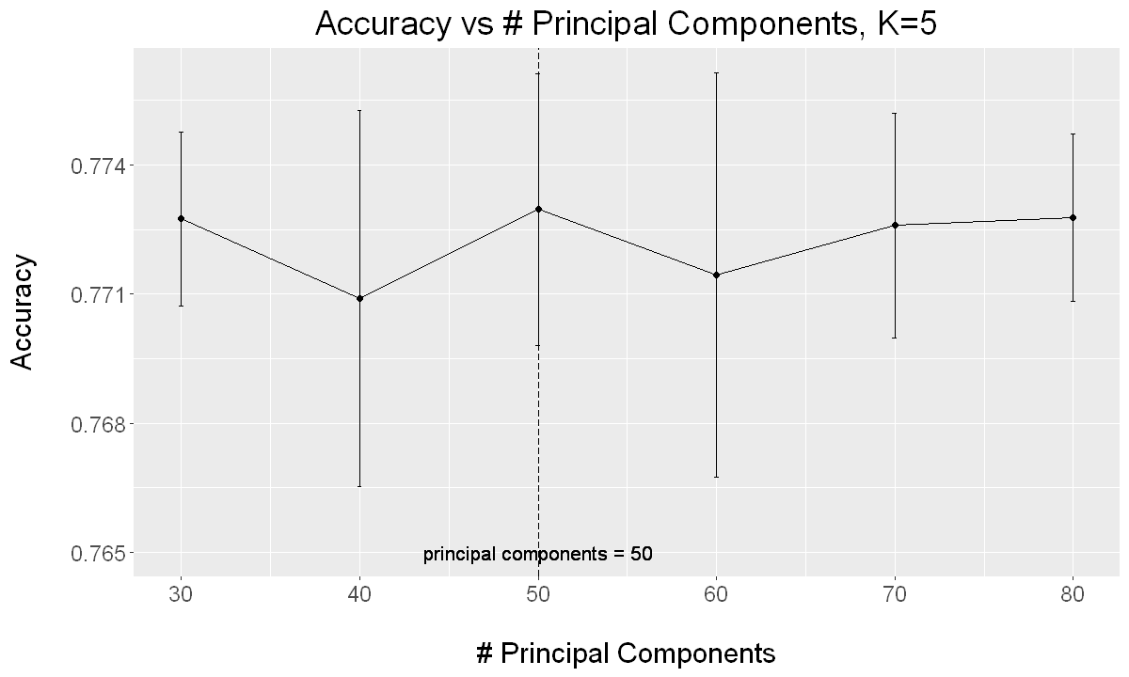
KNN with PCA
KNN simple model, performed well
Curse of high dimensionality
PCA
Notes:
The last strategy we tried was the combination of KNN with PCA. We saw that KNN performed relatively well considering the simplicity of the model (better than ann's did). We know the problem with knn is that they start performing worse as the dimensionality increases that is why we tried PCA to reduce the dimensionality and then perforrm KNN. We did a grid search on the amount of principal components and the amount of neighbours. We notices that 5 neighbours performed best, in the plot a 5 nearest neighbour model was cross validated with different numbers of principal components. We see that between 30 and 80 the accuracy is more of less stagnant. 50 performed best but the difference with 30 is not significant. This is a very simpel with still a good accuracy.

Slide 42

Conclusion
Extensive Feature Analysis, a lot of redundant data
Tree based models performed best but no free lunch.
Class imbalance had a big effect, bad performance on functional needs repair class
Ensemble as final model
Notes:
I will end this presentation with a small conclusion. We did a very extensive feature analysis, as there was a lot of reduntant data.
Tree based models outperformed all other models in our project, but as the no free lunch theore says, there is no single model which will always do better.
Class imbalance has a big effect on the accuracy, which is seen in the bad performance on the functional needs repair class.
We end with some ensemble models which turned out to be the best performers.

